Slide 1

SITA1503 Fog and Cloud Computing
Notes:
This template can be used as a starter file for presenting training materials in a group setting.
Sections
Right-click on a slide to add sections. Sections can help to organize your slides or facilitate collaboration between multiple authors.
Notes
Use the Notes section for delivery notes or to provide additional details for the audience. View these notes in Presentation View during your presentation.
Keep in mind the font size (important for accessibility, visibility, videotaping, and online production)
Coordinated colors
Pay particular attention to the graphs, charts, and text boxes.
Consider that attendees will print in black and white or grayscale. Run a test print to make sure your colors work when printed in pure black and white and grayscale.
Graphics, tables, and graphs
Keep it simple: If possible, use consistent, non-distracting styles and colors.
Label all graphs and tables.

Slide 2
Unit 1 Understanding Cloud Computing
Topics:
Basic Concepts and Terminology - Cloud Computing Architectural Framework - Types of Clouds - pros and cons of cloud computing – Cloud Characteristics - difference between web 2.0 and cloud - key challenges in cloud computing - Major
Cloud players - Virtualization in Cloud Computing - Parallelization in Cloud Computing - cloud resource management – Cloud Enabling Technology.
Notes:
Give a brief overview of the presentation. Describe the major focus of the presentation and why it is important.
Introduce each of the major topics.
To provide a road map for the audience, you can repeat this Overview slide throughout the presentation, highlighting the particular topic you will discuss next.

Slide 3
Introduction to Cloud Computing
Cloud computing is the on-demand availability of computer system resources, especially data storage and computing power, without direct active management by the user.
The term is generally used to describe data centers available to many users over the Internet. Large clouds, predominant today, often have functions distributed over multiple locations from central servers.
If the connection to the user is relatively close, it may be designated an edge server.
Notes:
Give a brief overview of the presentation. Describe the major focus of the presentation and why it is important.
Introduce each of the major topics.
To provide a road map for the audience, you can repeat this Overview slide throughout the presentation, highlighting the particular topic you will discuss next.

Slide 4
History of Cloud computing
Cloud computing has as its antecedents both client/server computing and peer-to-peer distributed computing. It’s all a matter of how centralized storage facilitates collaboration and how multiple computers work together to increase computing power.
Notes:
Give a brief overview of the presentation. Describe the major focus of the presentation and why it is important.
Introduce each of the major topics.
To provide a road map for the audience, you can repeat this Overview slide throughout the presentation, highlighting the particular topic you will discuss next.

Slide 5
History of Cloud computing
1960
1970
Multics (on GE hardware), Cambridge CTSS, and the earliest UNIX ports (on DEC hardware)
1990
Virtual Private Network (VPN) services with comparable quality of service, but at a lower cost
Initial concepts of time-sharing became popularized via RJE (Remote Job Entry) – IBM(International Business Machines), DEC(Digital Equipment Corporation)
2006
Amazon created subsidiary Amazon Web Services and introduced its Elastic Compute Cloud (EC2)
2008
Google App Engine
NASA's OpenNebula, enhanced in the RESERVOIR European Commission-funded project, became the first open-source software,
U.S. National Science Foundation began the Cluster Exploratory program to fund academic research using Google-IBM cluster technology to analyze massive amounts of data
Notes:
This is another option for an Overview slide.

Slide 6
History of Cloud computing….
2010
2011
IBM announced the IBM SmartCloud framework to support Smarter Planet.Among the various components of the Smarter Computing foundation, cloud computing is a critical part
2012
Oracle announced the Oracle Cloud. This cloud offering is poised to be the first to provide users with access to an integrated set of IT solutions, including the Applications (SaaS), Platform (PaaS), and Infrastructure (IaaS) layers.
Microsoft released Microsoft Azure
Rackspace Hosting and NASA jointly launched an open-source cloud-software initiative known as OpenStack
Google Compute Engine was released in preview
2019
Linux is most used on Microsoft Azure.
Notes:
This is another option for an Overview slide.

Slide 7
Cloud Architecture
NIST Architectural Framework - The NIST model
The United States government is a major consumer of computer services and, therefore, one of the major users of cloud computing networks. The U.S. National Institute of Standards and technology.
The National Institute of Standards and Technology(NIST) model originally did not require a cloud to use virtualization to pool resources, nor did it absolutely require that a cloud support multi-tenancy in the earliest definitions of cloud computing.
Multi-tenancy is the sharing of resources among two or more clients.
The latest version of the NIST definition does require that cloud computing networks use virtualization and support multi-tenancy.
Notes:
Add slides to each topic section as necessary, including slides with tables, graphs, and images.
See next section for sample table, graph, image, and video layouts.

Slide 8
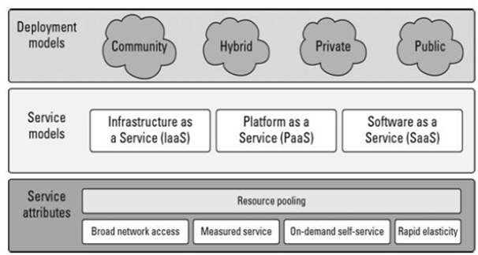
Cloud Architecture
NIST Architectural Framework - The NIST model
Because cloud computing is moving toward a set of modular interacting components based on standards such as the Service Oriented Architecture
The NIST cloud model doesn't address a number of intermediary services such as transaction or service brokers, provisioning, integration, and interoperability services that form the basis for many cloud computing paradigms
Notes:
Add slides to each topic section as necessary, including slides with tables, graphs, and images.
See next section for sample table, graph, image, and video layouts.

Slide 9
Types of Cloud
Public Cloud
Private Cloud
Hybrid Cloud
Multi-Cloud
Location Based
Service Based
Infrastructure as a Service
Platform as a Service
Software as a Service
IdaaS, Identity as a Service
CmaaS, Compliance as a Service

Slide 10
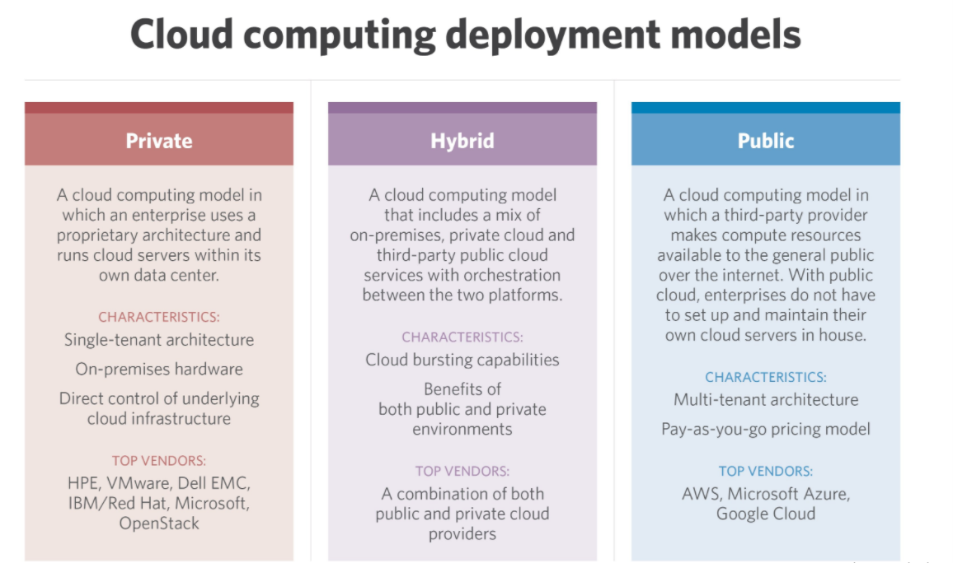

Slide 11
Location based Cloud types
Public cloud
The public cloud is defined as computing services offered by third-party providers over the public Internet, making them available to anyone who wants to use or purchase them. They may be free or sold on-demand, allowing customers to pay only per usage for the CPU cycles, storage or bandwidth they consume.
Examples:
Some of the popular examples of public clouds include Amazon Elastic Cloud Compute(EC2), Google App Engine, Blue Cloud by IBM and Azure services Platform by Windows

Slide 12
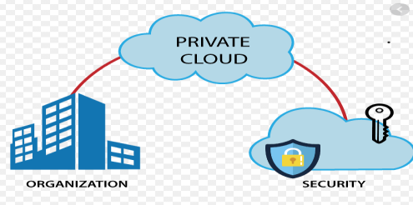
Location based Cloud types
Private cloud
A private cloud is a single-tenant environment, meaning the organization using it (the tenant) does not share resources with other users. Those resources can be hosted and managed in a variety of ways. The private cloud might be based on resources and infrastructure already present in an organization's on-premises data center or on new, separate infrastructure, which is provided by a third-party organization. In some cases, the single-tenant environment is enabled solely using virtualization software. In any case, the private cloud and its resources are dedicated to a single user or tenant.
Examples:
HP Data Centers, Microsoft, Elastra-private cloud, and Ubuntu are the example of a private cloud.

Slide 13
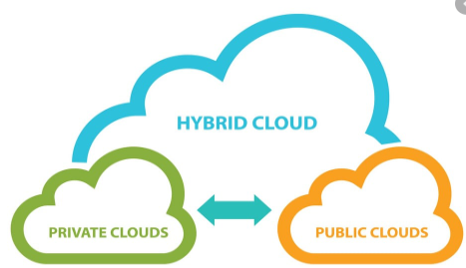
Location based Cloud types
Hybrid cloud is a solution that combines a private cloud with one or more public cloud services, with proprietary software enabling communication between each distinct service. A hybrid cloud strategy provides businesses with greater flexibility by moving workloads between cloud solutions as needs and costs fluctuate.
Hybrid CSPs:
Amazon
Microsoft
Google
Cisco
NetApp

Slide 14
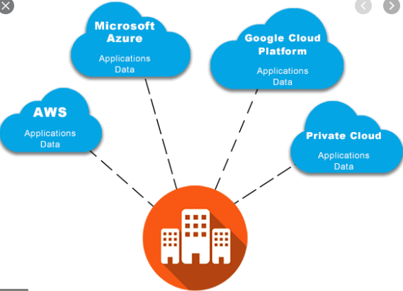
Location based Cloud types
Multi-cloud is the use of two or more cloud computing services from any number of different cloud vendors. A multi-cloud environment could be all-private, all-public or a combination of both. Companies use multi-cloud environments to distribute computing resources and minimize the risk of downtime and data loss.
Example:
Microsoft Azure
Vsphere
Vmware
AWS

Slide 15
Location based Cloud types Multicloud Vs Hybrid cloud
Hybrid cloud and multicloud may have similar attributes, but at the operational level, there are several differences. Hybrid clouds require more focus on the native operational tools while multicloud required focus and investment on third-party tools. In a multicloud environment, both the cloud vendor and your organization share the responsibility for the data security, while in a hybrid cloud, you have more responsibility as well as control over the data and its security. Also, every cloud has its own benefits and drawbacks, along with associated price tags. Doing a performance analysis of the existing workloads against the service offerings provided by each public cloud can help get an idea of the total cost of ownership (TCO) and return on investment (ROI) and thus selecting the right choice for your organization.

Slide 16
Service Based Cloud Types
Infrastructure as a Service:
IaaS provides virtual machines, virtual storage, virtual infrastructure,and other hardware assets as resources that clients can provision.
The IaaS service provider manages all the infrastructure, while the client is responsible for all other aspects of the deployment. This can include the operating system, applications, and user interactions with the system.

Slide 17
Service Based Cloud Types
Infrastructure as a Service:
Examples:
Amazon Elastic Compute Cloud (EC2)
Eucalyptus
GoGrid
FlexiScale
Linode
RackSpace Cloud
Terremark

Slide 18
Service Based Cloud Types
Platform as a Service:
PaaS provides virtual machines, operating systems, applications, services, development frameworks, transactions, and control structures. The client can deploy its applications on the cloud infrastructure or use applications that were programmed using languages and tools that are supported by the PaaS service provider. The service provider manages the cloud infrastructure, the operating systems, and the enabling software. The client is responsible for installing and managing the application that it is deploying.

Slide 19
Service Based Cloud Types
Platform as a Service Examples:
Force.com
GoGrid CloudCenter
Google AppEngine
Windows Azure Platform

Slide 20
Service Based Cloud Types
Software as a Service: SaaS is a complete operating environment with applications, management,and the user interface.In the SaaS model, the application is provided to the client through a thin client interface (a browser,usually), and the customer's responsibility begins and ends with entering and managing its data and user interaction. Everything from the application down to the infrastructure is the vendor's responsibility.
The three different service models taken together have come to be known as the SPI model of cloud computing. Many other service models have been mentioned: StaaS, Storage as a Service;

Slide 21
Service Based Cloud Types
Identity as a Service:
Identity as a Service, or IDaaS is cloud-based authentication built and operated by a third-party provider. IDaaS companies supply cloud-based authentication or identity management to enterprises who subscribe.
The X-as-a-service model in information technology is easy to understand. It means some feature is being delivered or served to a company through a remote connection from a third-party provider, as opposed to a feature being managed on site and by in-house personnel alone. Think of local email, such as Microsoft Outlook or Thunderbird, operating primarily on one's own computer versus cloud email, such as Gmail, being provided to users as a service through web connections. Identity, security, and other features can similarly be provided as a service.
The goal of an Identity Service is to ensure users are who they claim to be, and to give them the right kinds of access to software applications, files, or other resources at the right times. If the infrastructure to make this happen is built on site, then the company has to figure out what to do every time a problem comes up. If Bring Your Own Device (BYOD) employees are changing to different types of phones, for example, the local identity provisioning has to adapt immediately. It is much simpler to implement a centralized cloud-based system created by identity experts who have already solved such problems for hundreds of organizations.

Slide 22
Service Based Cloud Types
Compliance as a Service(CaaS) is a framework that enables companies to outsource roles, figures, and skills needed to implement and maintain compliance, to facilitate and simplify adherence with regulatory requirements

Slide 23
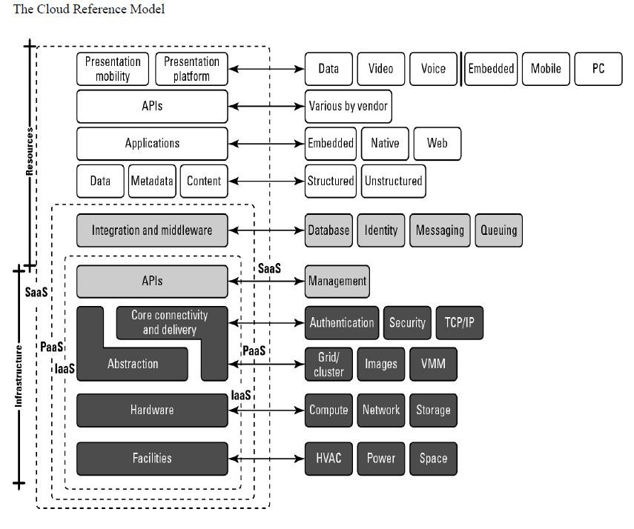
The Cloud Reference Model

Slide 24
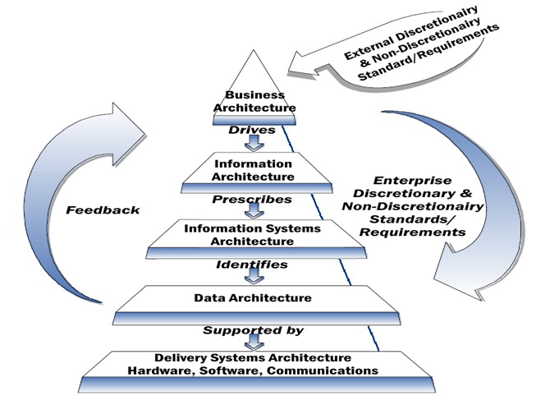
NIST Architecture Styles National Institute of Standards and Technology

Slide 25
NIST Architecture Styles National Institute of Standards and Technology
Business Architecture level: This level can picture the total or a subunit of any corporation, which are in contact with external organizations.
Information architecture level: This level specifies types of content, presentation forms, and format of the information required.
Information systems architecture level: Specifications for automated and procedure-oriented information systems.
Data Architecture level: Framework for maintenance, access and use of data, with data dictionary and other naming conventions.
Data Delivery Systems level: Technical implementation level of software, hardware, and communications that support the data architecture.

Slide 26
Merits and Demerits of Cloud Computing

Slide 27
Merits of Cloud Computing
Cloud Computing: Advantages Lower-Cost Computers for Users
Here’s a quantitative financial advantage: You don’t need a high-powered (and accordingly high-priced) computer to run cloud computing’s web-based applications. Because the application runs in the cloud, not on the desktop PC, that desktop PC doesn’t need the processing power or hard disk space demanded by traditional desktop software. Hence the client computers in cloud computing can be lower priced, with smaller hard disks, less memory,more efficient processors, and the like. In fact, a client computer in this scenario wouldn’t even need a CD or DVD drive, because no software programs have to be loaded and no document files need to be saved.

Slide 28
Merits of Cloud Computing
Improved Performance
Computers in a cloud computing system will boot up faster and run faster, because they’ll have fewer programs and processes loaded into memory.
Lower IT Infrastructure Costs
In a larger organization, the IT department could also see lower costs from the adoption of the cloud computing paradigm. Instead of investing in larger numbers of more powerful servers, the IT staff can use the computing power of the cloud to supplement or replace internal computing resources. Those companies that have peak needs no longer have to purchase equipment to handle the peaks (and then lay fallow the rest of the time); peak computing needs are easily handled by computers and servers in the cloud.

Slide 29
Merits of Cloud Computing
Fewer Maintenance Issues
Speaking of maintenance costs, cloud computing greatly reduces both hardware and software maintenance for organizations of all sizes. First, the hardware. With less hardware (fewer servers) necessary in the organization, maintenance costs are immediately lowered. As to software maintenance, remember that all cloud apps are based elsewhere, so there’s no software on the organization’s computers for the IT staff to maintain. It’s that simple.

Slide 30
Merits of Cloud Computing
Lower Software Costs
Then there’s the issue of software cost. Instead of purchasing separate software packages for each computer in the organization, only those employees actually using an application need access to that application in the cloud. Even if it costs the same to use web-based applications as it does similar desktop software (which it probably won’t), IT staffs are saved the cost of installing and maintaining those programs on every desktop in the organization. As to the cost of that software, it’s possible that some cloud computing companies will charge as much to “rent” their apps as traditional software companies charge for software purchases. However, early indications are that cloud services will be priced substantially lower than similar desktop software. In fact, many companies (such as Google) are offering their web-based applications for free—which to both individuals and large organizations is much more attractive than the high costs charged by Microsoft and similar desktop software suppliers.

Slide 31
Merits of Cloud Computing
Instant Software Updates
Another software-related advantage to cloud computing is that users are no longer faced with the choice between obsolete software and high upgrade costs. When the app is web-based, updates happen automatically and are available the next time the user logs in to the cloud. Whenever you access a web-based application, you’re getting the latest version—without needing to pay for or download an upgrade.

Slide 32
Merits of Cloud Computing
Increased Computing Power
This is an obvious one. When you’re tied into a cloud computing system, you have the power of the entire cloud at your disposal. You’re no longer limited to what a single desktop PC can do, but can now perform supercomputing-like tasks utilizing the power of thousands of computers and servers. In other words, you can attempt greater tasks in the cloud than you can on your desktop.

Slide 33
Merits of Cloud Computing
Unlimited Storage Capacity
Similarly, the cloud offers virtually limitless storage capacity. Consider that when your desktop or laptop PC is running out of storage space. Your computer’s 200GB hard drive is peanuts compared to the hundreds of petabytes (a million gigabytes) available in the cloud. Whatever you need to store, you can.

Slide 34
Merits of Cloud Computing
Increased Data Safety
And all that data you store in the cloud? It stays in the cloud—somewhere. Unlike desktop computing, where a hard disk crash can destroy all your valuable data, a computer crashing in the cloud doesn’t affect the storage of your data. That’s because data in the cloud is automatically duplicated, so nothing is ever lost. That also means if your personal computer crashes, all your data is still out there in the cloud, still accessible. In a world where few individual desktop PC users back up their data on a regular basis, cloud computing can keep data safe.

Slide 35
Merits of Cloud Computing
Improved Compatibility between Operating Systems
Ever try to get a Windows-based computer to talk to a Mac? Or a Linux machine to share data with a Windows PC? It can be frustrating. Not so with cloud computing. In the cloud, operating systems simply don’t matter. You can connect your Windows computer to the cloud and share documents with computers running Apple’s Mac OS, Linux, or UNIX. In the cloud, the data matters, not the operating system.

Slide 36
Merits of Cloud Computing
Improved Document Format Compatibility
You also don’t have to worry about the documents you create on your machine being compatible with other users’ applications or operating systems. In a world where Word 2007 documents can’t be opened on a computer running Word 2003, all documents created by web-based applications can be read by any other user accessing that application. There are no format incompatibilities when everyone is sharing docs and apps in the cloud.

Slide 37
Merits of Cloud Computing
Easier Group Collaboration
Sharing documents leads directly to collaborating on documents. To many users, this is one of the most important advantages of cloud computing: the ability for multiple users to easily collaborate on documents and projects. Imagine that you, a colleague in your West Coast office, and a consultant in Europe all need to work together on an important project. Before cloud computing, you had to email or snail mail the relevant documents from one user
to another, and work on them sequentially. Not so with cloud computing. Now each of you can access the project’s documents simultaneously; the edits one user makes are automatically reflected in what the other users see onscreen. It’s all possible, of course, because the documents are hosted in the cloud, not on any of your individual computers. All you need is a computer with an Internet connection, and you’re collaborating. Of course, easier group collaboration means faster completion of most group projects, with full participation from all involved. It also enables group projects across different geographic locations. No longer does the group have to reside in a single office for best effect. With cloud computing, anyone anywhere can collaborate in real time. It’s an enabling technology.

Slide 38
Merits of Cloud Computing
Universal Access to Documents
Ever get home from work and realize you left an important document at the office? Or forget to take a file with you on the road? Or get to a conference and discover you forgot to bring along your presentation? Not a problem—not anymore, anyway. With cloud computing, you don’t take your documents with you. Instead, they stay in the cloud, where you can access them from anywhere you have a computer and an Internet connection. All your documents are instantly available from wherever you are. There’s simply no need to take your documents with you—as long as you have an Internet connection, that is.

Slide 39
Merits of Cloud Computing
Latest Version Availability
And here’s another document-related advantage of cloud computing. When you edit a document at home, that edited version is what you see when you access the document at work. The cloud always hosts the latest version of your documents; you’re never in danger of having an outdated version on the computer you’re working on.

Slide 40
Merits of Cloud Computing
Removes the Tether to Specific Devices
Finally, here’s the ultimate cloud computing advantage—you’re no longer tethered to a single computer or network. Change computers, and your existing applications and documents follow you through the cloud. Move to a portable device, and your apps and docs are still available. There’s no need to buy a special version of a program for a particular device, or save your document in a device-specific format. Your documents and the programs that created them are the same no matter what computer you’re using.

Slide 41
Merits of Cloud Computing
Removes the Tether to Specific Devices
Finally, here’s the ultimate cloud computing advantage—you’re no longer tethered to a single computer or network. Change computers, and your existing applications and documents follow you through the cloud. Move to a portable device, and your apps and docs are still available. There’s no need to buy a special version of a program for a particular device, or save your document in a device-specific format. Your documents and the programs that created them are the same no matter what computer you’re using.

Slide 42
Demerits of Cloud Computing
Requires a Constant Internet Connection
Cloud computing is, quite simply, impossible if you can’t connect to the Internet. Because you use the Internet to connect to both your applications and documents, if you don’t have an Internet connection, you can’t access anything, even your own documents. A dead Internet connection means no work, period and in areas where Internet connections are few or inherently unreliable, this could be a deal breaker. When you’re offline, cloud computing just doesn’t work. This might be a more significant disadvantage than you might think. Sure, you’re used to a relatively consistent Internet connection both at home and at work, but where else do you like to use your computer? If you’re used to working on documents on your deck, or while you’re at a restaurant for lunch, or in your car, you won’t be able to access your cloud based documents and applications unless you have a strong Internet connection at all those locations, of course. A lot of what’s nice about portable computing becomes problematic when you’re depending on web-based applications.

Slide 43
Demerits of Cloud Computing
Doesn’t Work Well with Low-Speed Connections
Similarly, a low-speed Internet connection, such as that found with dial-up services, makes cloud computing painful at best and often impossible. Webbased apps often require a lot of bandwidth to download, as do large documents. If you’re laboring with a low-speed dial-up connection, it might take seemingly forever just to change from page to page in a document, let alone launch a feature-rich cloud service. In other words, cloud computing isn’t for the slow or broadband-impaired.

Slide 44
Demerits of Cloud Computing
Can Be Slow
Even on a fast connection, web-based applications can sometimes be slower than accessing a similar software program on your desktop PC. That’s because everything about the program, from the interface to the document you’re working on, has to be sent back and forth from your computer to the computers in the cloud. If the cloud servers happen to be backed up at that moment, or if the Internet is having a slow day, you won’t get the instantaneous access you’re used to with desktop apps.

Slide 45
Demerits of Cloud Computing
Features Might Be Limited
This particular disadvantage is bound to change, but today many web-based applications simply aren’t as full-featured as their desktop-based brethren. Compare, for example, the feature set of Google Presentations with that of Microsoft PowerPoint; there’s just a lot more you can do with PowerPoint than you can with Google’s web-based offering. The basics are similar, but the cloud application lacks many of PowerPoint’s advanced features. So if you’re an advanced user, you might not want to leap into the cloud computing waters just yet. That said, many web-based apps add more advanced features over time. This has certainly been the case with Google Docs and Spreadsheets, both of which started out somewhat crippled but later added many of the more niche functions found on Microsoft Word and Excel. Still, you need to look at the features before you make the move. Make sure that the cloud-based application can do everything you need it to do before you give up on your traditional software.

Slide 46
Demerits of Cloud Computing
Stored Data Might Not Be Secure
With cloud computing, all your data is stored on the cloud. That’s all well and good, but how secure is the cloud? Can other, unauthorized users gain access to your confidential data?So security is a major issue in cloud environment.

Slide 47
Demerits of Cloud Computing
Problem will arise If Data loss occurs
Theoretically, data stored in the cloud is unusually safe, replicated across multiple machines. But on the off chance that your data does go missing, you have no physical or local backup. (Unless you methodically download all your cloud documents to your own desktop, of course— which few users do.) Put simply, relying the cloud puts you at risk if the cloud lets you down. This is one of the major disadvantage of cloud.

Slide 48
Key challenges in cloud computing
Bandwidth cost
Cloud computing saves the hardware acquisition costs but their expenditure on bandwidth rises considerably.
Sufficient bandwidth is required to deliver intensive and complex data over the network.
Continuous monitoring and supervision
It is important to monitor the cloud service continuously as well as to supervise its performance, business dependency and robustness.
Security concerns
To prevent cloud infrastructure damages, some of the measures include tracking unusual behaviour across servers, buying security hardware and using security applications.

Slide 49
Key challenges in cloud computing
Data access and integration
In cloud where the data stored, how to access it, who is the owner and how to control it.
Companies are often concerned about data ownership and loss of data control while moving to cloud.
The integration of existing applications in the cloud for smooth running is another challenge.
Proper usability
Enterprises need to have a good and clear view of how to use the technology to add value to their unique businesses

Slide 50
Key challenges in cloud computing
Migration issues
Migrating data from system to the cloud can pose major risks, if it not handled properly.
It need to develop migration strategy that integrates well with the current IT infrastructure.
Cost assessment
Scalable and on-demand nature of cloud services makes the assessment of cost difficult.
Heavy use of a service for a few days may consume the budget of several months.

Slide 51
Current Cloud Computing Challenges
1.Managing multi-cloud environments:
Most of the organizations are not using one cloud. From the survey of Right Scale findings, it is estimated that almost 81% of all the entrepreneurs are using multi-cloud strategy. The multi-cloud environment is increasing the complexity faced by IT companies. Doing practices like training employees, doing research, actively managing vendor relationships, tooling and rethinking process.

Slide 52
Current Cloud Computing Challenges
2.Migration:
Moving the existing application into the cloud is the most difficult task. A dimension research study found that mostly 62% of the cloud migration projects are most difficult than it is to be expected.55% exceeding their budget while 64% is taking longer than to be expected. All the migration projects are troubleshooting, time-consuming, slow migration of data and difficulty security configuration, difficulty syncing data before cutover, downtime during migration and trouble during migration tools to work properly. To overcome all these major IT challenges hiring in-house experts, set a longer project timeline, increase budget.

Slide 53
Current Cloud Computing Challenges
3.Vendor Lock-In:
Many vendors like Microsoft Azure, IBM cloud, Google cloud platform, Amazon Web Services are dominating the public cloud market. That’s because of the buyer’s caution. Ensure that the services you use are unique and can be transported to other providers, and most importantly, understand the requirements. It could be that this service is not standard or there is no decent vendor replacement. Entering the cloud computing agreement is easier than leaving it.

Slide 54
Current Cloud Computing Challenges
4.Reliability of new technology:
Security threads increase because they do not know and where information is stored and processed. Usually, employers are hesitant to share organizational information with unknown service providers. This is a fact of human nature that we believe in things that are before our eyes. They think that the information stored in their offices is safer and more accessible. By using cloud computing, they fear losing control of data. They think that data is taken from them and submitted to unknown third parties. The fear of these unknown service providers must be peacefully dealt with and removed from their minds.

Slide 55
Current Cloud Computing Challenges
5.Operational Security:
A major fear of cloud service providers is cyber attacks which is an operational security issue. Most of the data stored in the cloud are at a risk of cyber attack where an only limited amount of data is to be stored. Vulnerability assessment on the overall security measures of providers against external attacks is an effective way to ensure that data in the cloud is adequately protected. The high threat level is because the targets are often by malware, virtual machines and brute force attacks. Even as most cloud providers have strict security measures, cyber attacks are always looming. The high threat level is because the targets are often by malware, virtual machines and brute force attacks.

Slide 56
Current Cloud Computing Challenges
6.Cost Barrier:
To transfer complex and intensive data over the network, you must have sufficient bandwidth. This is a major obstacle in front of small organizations, which limits them from implementing cloud technology in their business. Businesses can reduce costs on hardware but they have to spend a large amount on bandwidth. For smaller application costs it’s not a big problem but for large and complex applications it’s a major problem. For efficient cloud computing work, you have to bear high bandwidth costs.

Slide 57
Current Cloud Computing Challenges
7.Reducing the risk of threats:
Organizations must observe and examine threats very seriously. Every organization may not have enough mechanisms to reduce this type of threat. It’s very complicated to say that cloud service providers meet security standards and threat risks. These security threats and risks examine the application of cloud solutions.

Slide 58
Current Cloud Computing Challenges
8.Hacking of the brand:
Cloud providers accommodate many clients; each can be influenced by actions taken against one of them. When there is a threat coming to the main server it also affects all other clients too. Hard computing brings several main risk factors such as hacking. Some professional hackers can hack applications by breaking down firewalls efficiently and stealing sensitive information from organizations. As in the rejection of requests for server attack services that flooded providers of widely distributed computers.

Slide 59
Current Cloud Computing Challenges
9.Password security:
Password security plays a crucial role in cloud security. Since many people are having access to cloudless security concern is there. If anyone who had knowledge about your password can access your account which you stored in the cloud. Multi-factor authentication should be employed to make sure password is protected properly particularly when the staff members leave. Access rights should be given to those who are related to username and password and it should be allocated for those who require them.

Slide 60
Current Cloud Computing Challenges
10.Management of cloud:
Cloud services can be easily changed and updated by business users. It does not involve the direct involvement of the IT department. It is the responsibility of the service provider to manage information and disseminate it throughout the organization. Many famous dramatic predictions about the impact of cloud computing. People think that traditional IT departments will be outdated and research supports the conclusion that cloud impacts tend to be more gradual and less linear. It consists of many technical challenges. So it’s difficult to manage all the functions of complex cloud computing

Slide 61
Difference: Cloud and Web 2.0
Cloud Computing | Web 2.0
It is more specific and definite | Programming and business models
It is a way of searching through data. | It is sharing entire pieces of data between different websites.
Cloud computing is about computers. | Web 2.0 is about people.
The internet as a computing platform | Attempt to explore and explain the business rules of that platform
Google apps are considered in Cloud computing. | A web-based application is considered in Web 2.0.
It is a business model for hosting these services. | It is a technology which allows webpages to act as more responsive applications

Slide 62
Major cloud players
Microsoft Azure
Amazon Web Services (AWS)
Google Cloud
Alibaba Cloud
IBM Cloud
Oracle
Salesforce
SAP
Rackspace Cloud
VMWare
*Amazon Web Services offers many types of cloud computing services. See the website for details.
**VMware is a provider of the technology underlying cloud computing and does not provide hosting services.

Slide 63
The Top 5 Cloud-Computing Vendors:
#1 Microsoft remains an absolute lock at the top due to four factors: its deep involvement at all three layers of the cloud (IaaS, PaaS and SaaS); its unmatched commitment to developing and helping customers deploy AI, ML and Blockchain in innovative production environments; its market-leading cloud revenue, which I estimate at about $16.7 billion for the trailing 12 months (not to be confused with the forward-projected $20.4 billion annualized run rate the company released on Oct. 26); and the extraordinary vision and leadership of CEO Satya Nadella.

Slide 64
The Top 5 Cloud-Computing Vendors:
#2 Amazon might not have the end-to-end software chops of the others in the Top 5 but it was and continues to be the poster-child for the cloud-computing movement: the first-moving paradigm-buster and category creator. I believe Amazon will make some big moves to bolster its position in software, and no matter how you slice it, the $16 billion in trailing-12-month cloud revenue from AWS is awfully impressive.

Slide 65
The Top 5 Cloud-Computing Vendors:
#3 IBM has leapfrogged both Salesforce.com (formerly tied with Amazon for #2 and now in the #4 spot) and SAP (SAP stands for Systems Applications and Products in Data Processing. SAP is an ERP software that helps run the day to day operations of an enterprise) on the strength of its un-trendy but highly successful emphasis on transforming its vast array of software expertise and technology from the on-premises world to the cloud. In so doing, IBM has quietly created a $15.8-billion cloud business (again on trailing-12-month basis) that includes revenue of $7 billion from helping big global corporations convert legacy systems to cloud or cloud-enabled environments. And like #1 Microsoft, IBM plays in all three layers of the cloud—IaaS, PaaS and SaaS—which is hugely important for the elite cloud vendors because it allows them to give customers more choices, more seamless integration, better cybersecurity, and more reasons for third-party developers to rally to the IBM Cloud. Plus, its relentless pairing of "cloud and cognitive" is an excellent approach toward weaving AI and ML deeply into customer-facing solutions.

Slide 66
The Top 5 Cloud-Computing Vendors:
#4 Salesforce.com falls a couple of spots from its long-time tie with Amazon at #2 but—and this will be the case as long as founder Marc Benioff is CEO—remains a powerful source of digital innovation and disruptive strategy. However, to remain in the rarified air near the top of the Cloud Wars Top 10, Benioff and Salesforce must find a way to extend their market impact beyond their enormously successful SaaS business and become more of a high-impact player in the platform or PaaS space. At this stage, it's simply not possible for Salesforce to become a player in IaaS, so Benioff needs to crank up the genius machine and hammer his way into top contention as a platform powerhouse.

Slide 67
The Top 5 Cloud-Computing Vendors:
#5 SAP has what all of the other cloud vendors would kill for: unmatched incumbency within all of the world's leading corporations as the supplier of mission-critical business applications that run those companies. It's also fashioned, under CEO Bill McDermott, powerful new partnerships with Amazon and Google to complement its long-standing relationships with IBM and Microsoft, all of which give customers a heightened sense of confidence that SAP will be willing and able to play nice in heterogeneous environments. Plus, SAP's HANA technology is now in full deployment across thousands of businesses, and as it takes root and SAP continues to rationalize its massive product portfolio around HANA in the cloud, SAP has a very bright future ahead of it in the cloud.

Slide 68
References:
Cloud concepts : https://en.wikipedia.org/
Web Services: https://www.cleo.com/blog/knowledge-base-web-services
WSDL: https://www.w3schools.com/xml/xml_wsdl.asp
UDDI: https://www.tutorialspoint.com/uddi/uddi_overview.htm
Cloud types: https://www.vxchnge.com/blog/different-types-of-cloud-computing
Multicloud: https://www.ibm.com/cloud/learn/multicloud
Multicloud Vs Hybrid cloud: https://gcloud.devoteam.com/blog/differences-similarities-between-hybrid-cloud-multi-cloud

Slide 69
Virtualization
The term 'Virtualization' can be used in many respect of computer. It is the process of creating a virtual environment of something which may include hardware platforms, storage devices, OS, network resources, etc.
Virtualization is the ability which allows sharing the physical instance of a single application or resource among multiple organizations or users. This technique is done by assigning a name logically to all those physical resources & provides a pointer to those physical resources based on demand.
Over an existing operating system & hardware, we generally create a virtual machine which and above it we run other operating systems or applications. This is called Hardware Virtualization. The virtual machine provides a separate environment that is logically distinct from its underlying hardware. Here, the system or the machine is the host & virtual machine is the guest machine. This virtual environment is managed by a firmware which is termed as a hypervisor.

Slide 70
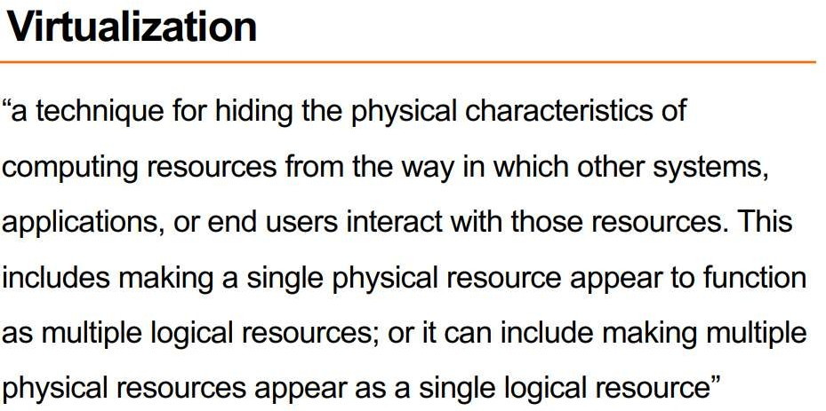

Slide 71
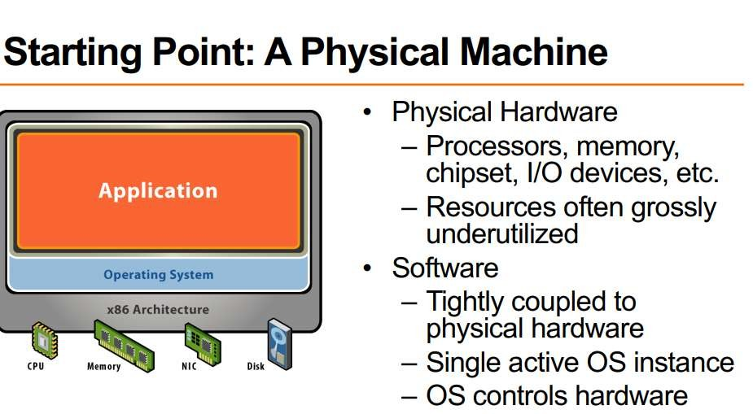

Slide 72
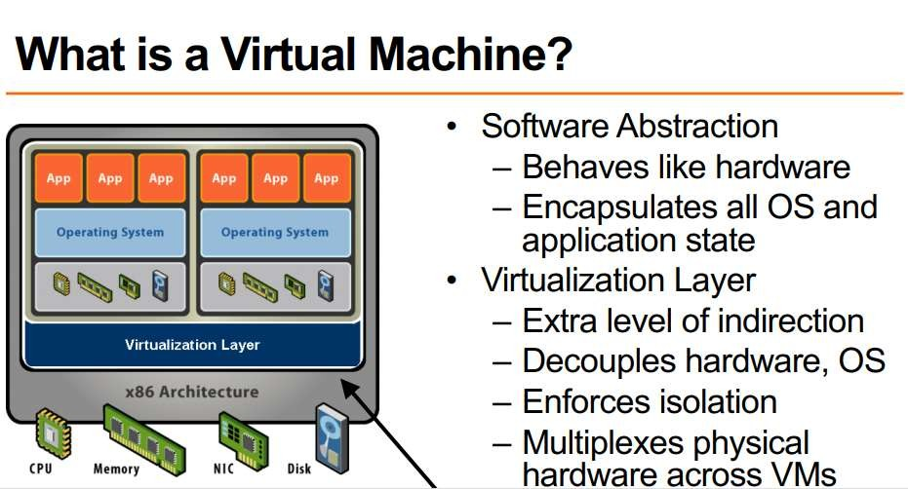

Slide 73
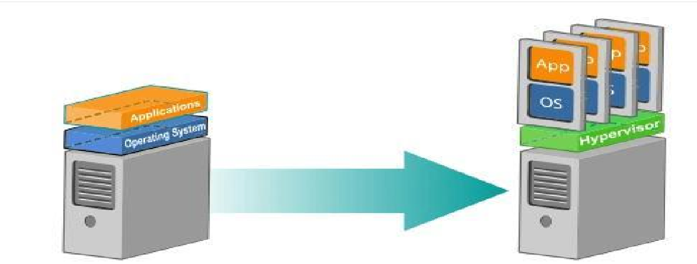
Virtualization in Cloud Computing

Slide 74
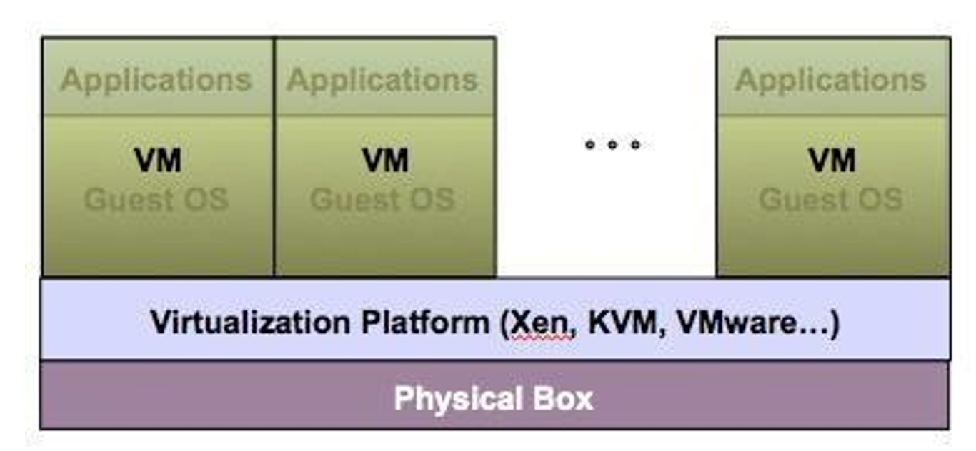
Virtualization Architecture

Slide 75
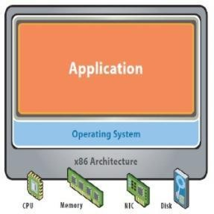
Before Virtualization
Single OS image per machine
Software and hardware tightly coupled
Running multiple applications on same machine often creates conflict
Inflexible and costly infrastructure

Slide 76
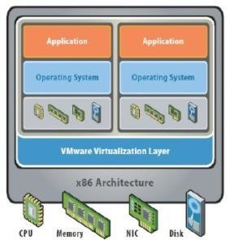
After Virtualization
Hardware-independence of operating system and applications
Virtual machines can be provisioned to any system
Can manage OS and application as a single unit by encapsulating them into virtual Machines

Slide 77
Benefits of Virtualization
Sharing of resources helps cost reduction.
Isolation: Virtual machines are isolated from each other as if they are physically separated.
Encapsulation: Virtual machines encapsulate a complete computing environment.
Hardware Independence: Virtual machines run independently of underlying hardware.
Portability: Virtual machines can be migrated between different hosts.

Slide 78
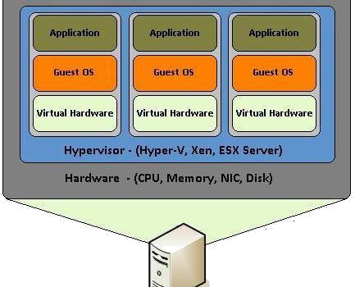
VMM/Virtualization Manager/Hypervisor

Slide 79
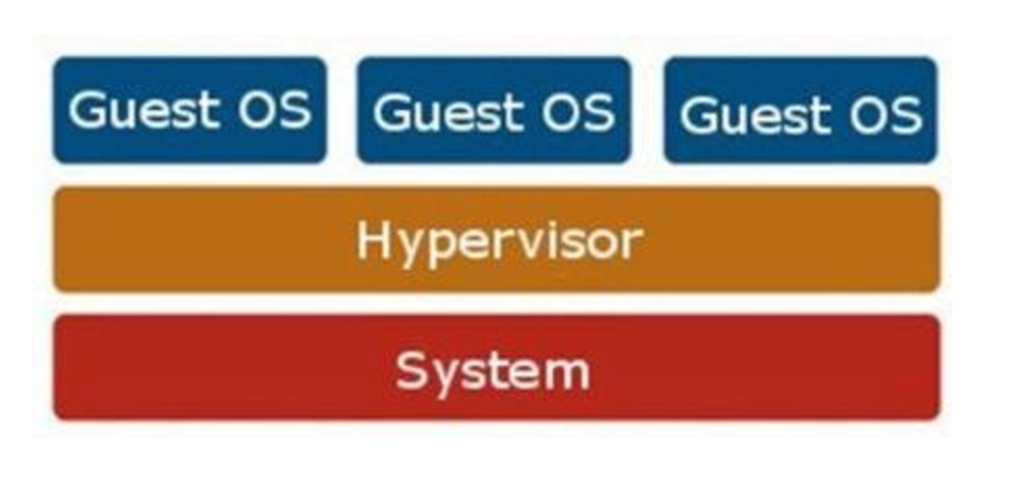
General structure of Hypervisor

Slide 80
Hypervisor
A hypervisor or virtual machine monitor (VMM) is computer software, firmware or hardware that creates and runs virtual machines. A computer on which a hypervisor runs one or more virtual machines is called a host machine, and each virtual machine is called a guest machine.
A hypervisor is a hardware virtualization technique that allows multiple guest operating systems (OS) to run on a single host system at the same time. The guest OS shares the hardware of the host computer, such that each OS appears to have its own processor, memory and other hardware resources.
A hypervisor is also known as a virtual machine manager (VMM).

Slide 81
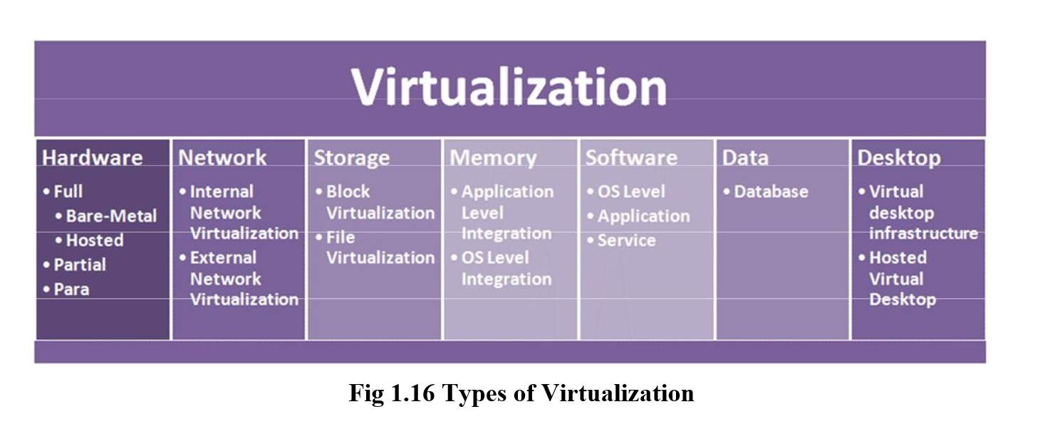
Types of Virtualization

Slide 82
Approaches or ways to virtualizes cloud servers.
Grid Approach
OS - Level Virtualization
Hypervisor-based Virtualization
Software virtualization
Hardware virtualization
Server virtualization

Slide 83
Virtualization
Grid Approach - where the processing workloads are distributed among different physical servers, and their results are then collected as one.
OS - Level Virtualization -Here, multiple instances of an application can run in an isolated form on a single OS
Hypervisor-based Virtualization-With hypervisor's virtualization, there are various sub- approaches to fulfill the goal to run multiple applications & other loads on a single physical host

Slide 84
Virtualization
Hardware Virtualization -It is the abstraction of computing resources from the software that uses cloud resources. It involves embedding virtual machine software into the server's hardware components. That software is called the hypervisor.

Slide 85
Virtualization
Three types of hardware virtualizations
Full Virtualization - Here the hardware architecture is completely simulated. Guest software doesn't need any modification to run any applications
Emulation Virtualization - Here the virtual machine simulates the hardware & is independent. Furthermore, the guest OS doesn't require any modification
Para-Virtualization - Here, the hardware is not simulated; instead the guest software runs its isolated system

Slide 86
Software virtualization
It is also called application virtualization
Software virtualization is similar to that of virtualization except that it is capable to abstract the software installation procedure and create virtual software installation. Many applications & their distributions became typical tasks for IT firms and departments. The mechanism for installing an application differs.
So virtualized software is introduced in which an application that will be installed into its self-contained unit and provide software virtualization. Some of the examples are Virtual Box, VMware, etc
Benefits are Ease of Client Deployment , Software Migration, Easy to Manage

Slide 87
Server virtualization:
In this process, the server resources are kept hidden from the user. This partitioning of physical server into several virtual environments; result in the dedication of one server to perform a single application or task.
This technique is mainly used in web-servers which reduces the cost of web-hosting services. Instead of having separate system for each web-server, multiple virtual servers can run on the same system/computer.

Slide 88
Primary uses of server virtualization are:
To centralize the server administration
Improve the availability of server
Helps in disaster recovery
Ease in development & testing
Make efficient use of server resources.

Slide 89
Parallelization in cloud computing
Parallel computing is a type of computing architecture in which several processors execute or process an application or computation simultaneously.
Parallel computing helps in performing large computations by dividing the workload between more than one processor, all of which work through the computation at the same time.
Most supercomputers implemented parallel computing principles to operate.
Parallel computing is also known as parallel processing.
Parallel processing is generally implemented in operational environments/scenarios that require massive computation or processing power.
The primary objective of parallel computing is to increase the available computation power for faster application processing.
Typically, parallel computing infrastructure is housed within a single facility where many processors are installed in a server rack or separate servers are connected together.
The application server sends a processing request that is distributed in small components, which are concurrently executed on each processor/server.
Parallel computation can be classified as bit-level, instructional level, data and task parallelism.

Slide 90
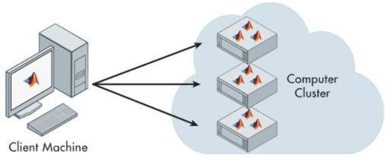
Parallelization in cloud computing

Slide 91
Cloud resource management
Critical function of any man-made system.
It affects the three basic criteria for the evaluation of a system like:
Functionality.
Performance.
Cost.

Slide 92
Scheduling
Scheduling in a computing system deciding how to allocate resources of a system, such as CPU cycles, memory, secondary storage space, I/O and network bandwidth, between users and tasks.
Policies and mechanisms for resource allocation.
Policy: principles guiding decisions.
Mechanisms: the means to implement policies

Slide 93
Cloud resource management (CRM) policies
1. Admission control: prevent the system from accepting workload in violation of high-level system policies.
2. Capacity allocation: allocate resources for individual activations of a service
3. Load balancing: distribute the workload evenly among the servers
4. Energy optimization: minimization of energy consumption
5. Quality of service (QoS) guarantees: ability to satisfy timing or other conditions specified by a Service Level Agreement

Slide 94
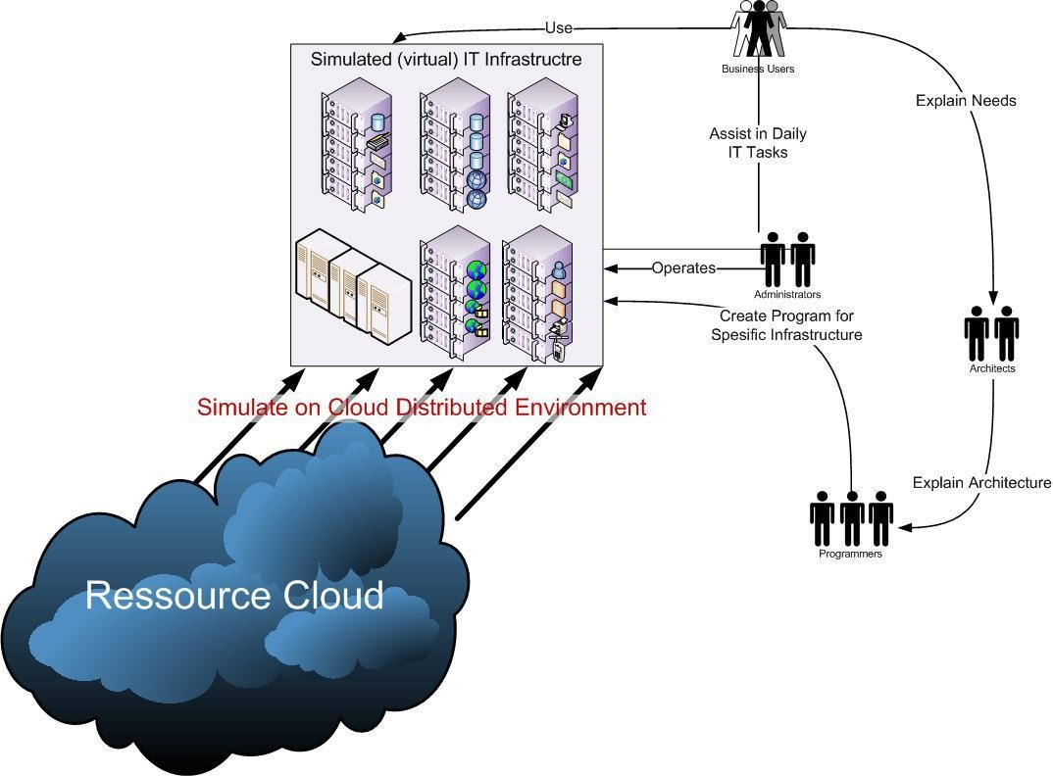
CRM

Slide 95
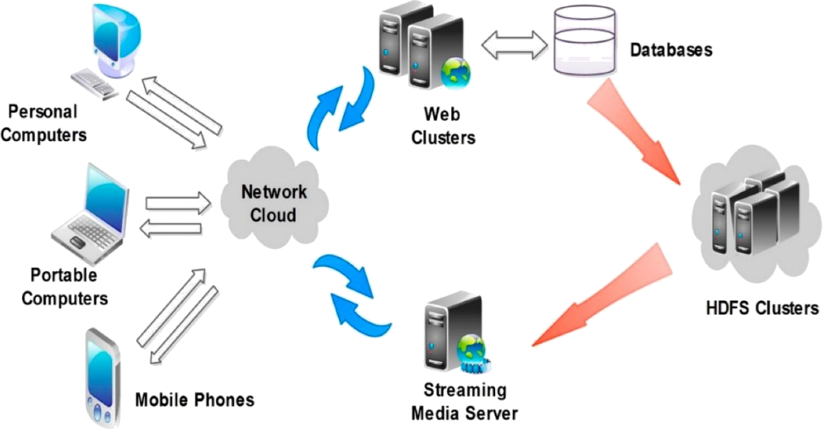
Devices connected across the cloud

Slide 96
Dynamic resource allocation
Cloud Computing environment can supply of computing resources on the basis of demand and when needed
Managing the customer demand creates the challenges of on-demand resource allocation.
Effective and dynamic utilization of the resources in cloud can help to balance the load and avoid
situations like slow run of systems.
Cloud computing allows business outcomes to scale up and down their resources based on needs.
Virtual Machines are allocated to the user based on their job in order to reduce the number of
physical servers in the cloud environment
If the VM is available then job is allowed to run on the VM.
If the VM is not available then the algorithm finds a low priority job taking into account the job’s lease type.

Slide 97
There are three types
Cancellable: These requests can be scheduled at any time after their arrival time
Suspendable: Suspendable leases are flexible in start time and can be scheduled at any time after their ready time
Non-Preemptable: The leases associated with such requests cannot be pre-empted at all.

Slide 98
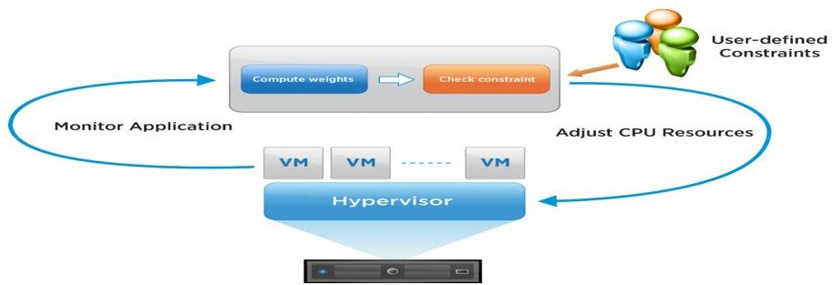
Dynamic Resource Allocation

Slide 99
Optimal allocation of cloud models
The optimal allocation of computing resources is a core part for implementing cloud computing.
High heterogeneity, high dynamism, and virtualization make the optimal allocation problem more complex than the traditional scheduling problems in grid system or cloud computing system.

Slide 100
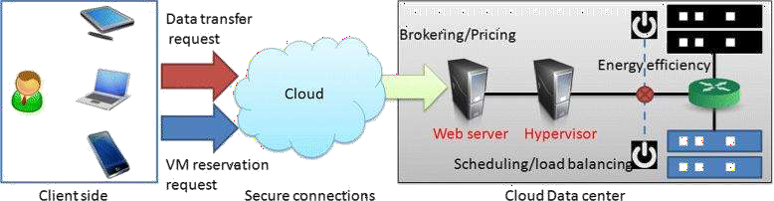
Optimal allocation of cloud models

Slide 101
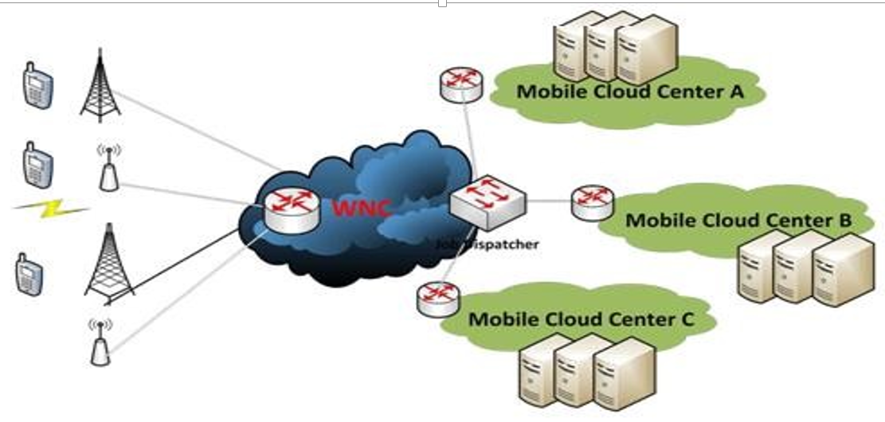
Resource allocation in a typical wireless network cloud

Slide 102
Cloud Enabling Technologies
The key enabling technologies for Cloud Computing are:
Distributed computing (cluster, Grid Computing)
Internet technologies (Service-oriented architecture, Web 3.0, etc.)
Hardware Technologies (Multi-core chips, Virtualizations, etc.)
System Management technologies (Automatics computing)

Slide 103
Quiz
https://forms.gle/yCP92iUP4D2nFjaK6

Slide 104
References
Cloud concepts : https://en.wikipedia.org/
Web Services: https://www.cleo.com/blog/knowledge-base-web-services
WSDL: https://www.w3schools.com/xml/xml_wsdl.asp
UDDI: https://www.tutorialspoint.com/uddi/uddi_overview.htm
Cloud types: https://www.vxchnge.com/blog/different-types-of-cloud-computing

Slide 105
Questions?

